Slide 1

Capstone Project 2020
Kortney Grayson

Slide 2
How does diabetes and other medical indicators impact patient length of stay within hospitals
The reason I chose this data set is due to my personal family history with Diabetes as well as knowing how it affects the community where I am from as whole. With the knowledge that Diabetes is the 7th highest cause of death in America it integral in my choosing this data set to further my understanding of the Disease.
My Grandfather was Diagnosed with Diabetes Decades ago and I was able to see up close and personal the many occasions where he had to be admitted into the hospital and not being able to get real clarification on when each instance would allow him to return home.
Using Data to provide clarification really opened my eyes to the many corresponding illnesses that can be aligned with Diabetes and how that can influence a patient's duration within a facility.
Upon this undertaking I was able to analyze data to reveal how Age, Ethnicity, Initial Diagnosis and Insulin Mediation and their effects on Hospital Stay.

Slide 3
Data Sources
My Data source was https://archive.ics.uci.edu/ml/datasets/diabetes+130-us+hospitals+for+years+1999-2008
Utilizing this Data Source along with The corresponding tables and descriptors I was able to decipher the data in a way was beneficial to my analysis, a lot of the fields have values that aren’t functional if you don’t understand the details behind it.
I also Referenced the Website for the American Diabetes Association. To understand of the financial implication's hospital stays has on the Economy.
https://diabetes.org/resources/statistics/cost-diabetes

Slide 4
The DATA!!!!(CALCULATED FIELDS)
I had to use several calculated fields to ensure my data could accurately depict the analysis I will be providing Below you will see a listing of all calculated fields created for this CAPSTONE PROJECT.
Time in Hospital from a Count to a date- DATE(DATEPARSE ( "dd", STR([Time In Hospital]) ))
Hospital Stay for LOD Graph- { FIXED [Patient Nbr]:ROUND(AVG([Time In Hospital]))}
Updating Gender By Looking at other factors- IF [Gender]= "Unknown/Invalid" THEN "Male“ ELSE [Gender] END
Not Available Text For Tool Tip- IF [Admission Type Descriptions]= "Not Available" THEN " No Information Was Given At Time Of Admission“ ELSE "“ END
Difference in Lab Work- SUM([Num Lab Procedures])/COUNTD([Encounter Id])
Readmission- IF [Readmitted] != "NO" THEN 1 ELSE 0 END
Readmission Percentage- SUM([Readmission])/SUM([Number of Records])
Complete Diagnosis-ifnull(STR([Diagnosis #1 Illness Type]),"")+ ifnull(STR([Diagnosis #2 illness Type]),"")+ ifnull(STR([Diagnosis #3 Illness Type]),"")

Slide 5
Charts and Analysis
Patient Overview

Slide 6

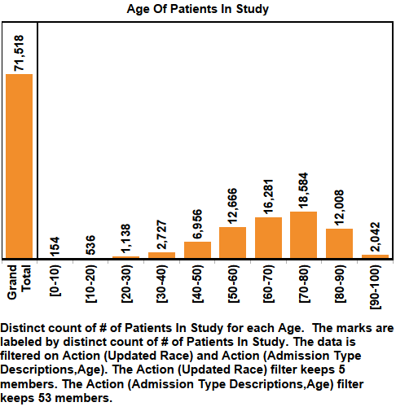
Patient Population and Admission Reason
In The Next 2 Slides I have looked at the population that has been analyzed and created graphs that distinguish between the ages and Ethnicities involved in the study. Additionally I felt it would be valuable to discern the different Admission types for this population.

Slide 7
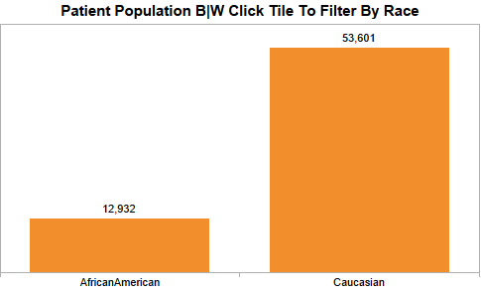
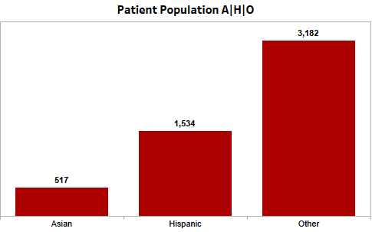
Population By Ethnicity

Slide 8
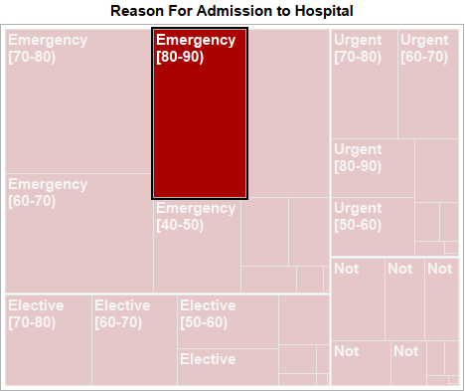
Reason For Hospital Admission
This Graph works in Tandem with the prior graphs to display they different reasons for admission to the hospital utilizing the filters of age and or ethnicity.

Slide 9
C&A II
Initial Diagnosis

Slide 10
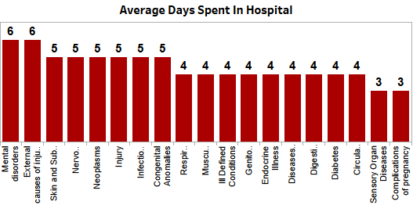
Initial Diagnosis Charts
These Four Graphs highlight the Average length of stay per initial diagnosis as well as the readmission percentages by age and by illness. These fields can be filtered by Age and Diagnosis.
In 2017 Inpatient Hospital care totaled over 71 Billion Dollars. Understanding which diagnosis requires more acute care could help to possible lowering the total stay duration for a patient.

Slide 11
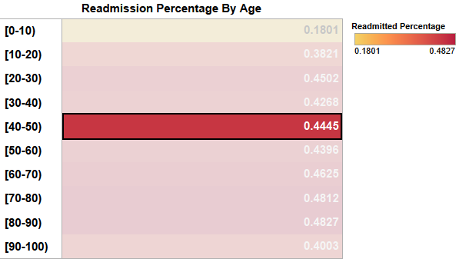
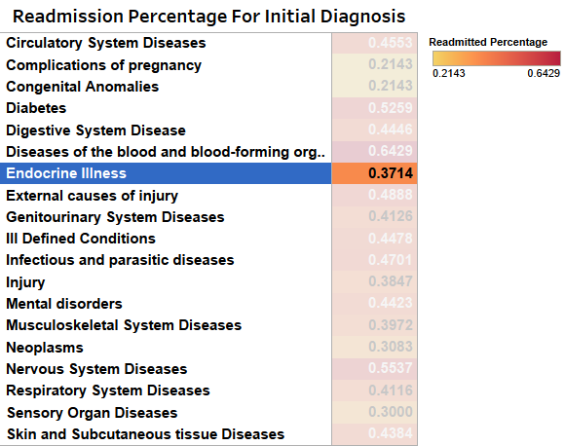
Readmission Percentages

Slide 12
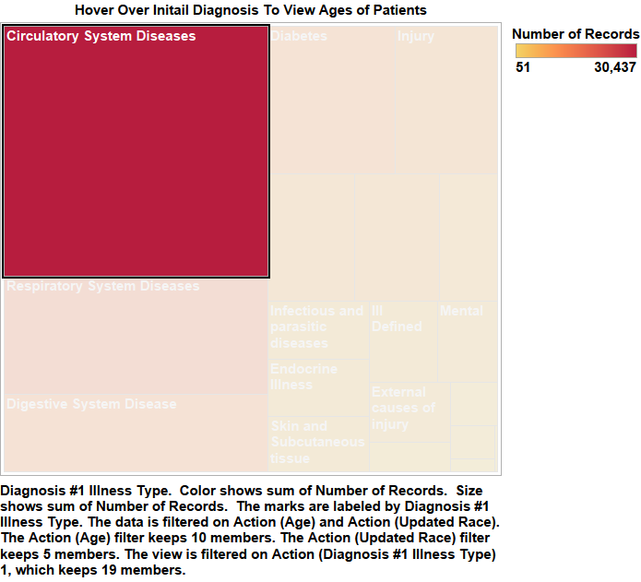
Diagnosis Tree map

Slide 13
C&a III
Insulin Monitoring And Lab Work

Slide 14
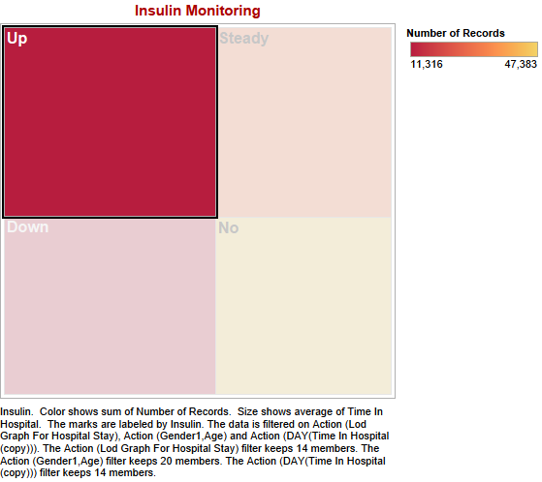

Insulin Levels and Lab Work
With The known importance of Insulin I wanted to monitor how the distinction of Insulin Levels would effect length of Hospital Stay. I Also wanted to Determine the change in Lab procedures as Hospital stays lengthened in time.

Slide 15
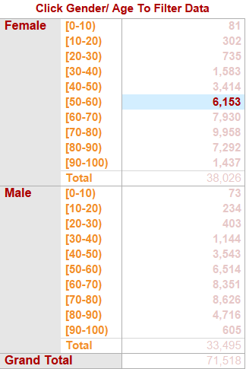
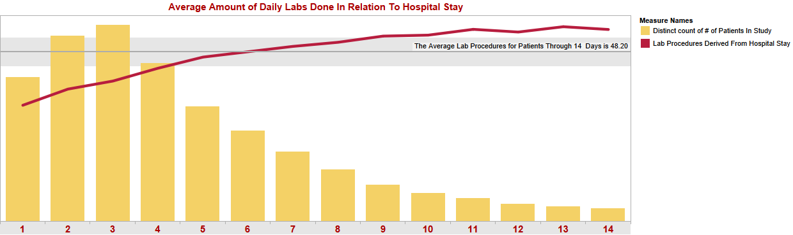
Filters For Age and Gender/Lab Work Per Hospital Stay

Slide 16
C&A IIII
EFFECTS OF ETHNICITY REGARDING PRIMARY DIAGNOSIS AND DISCHARGE LOCATION

Slide 17
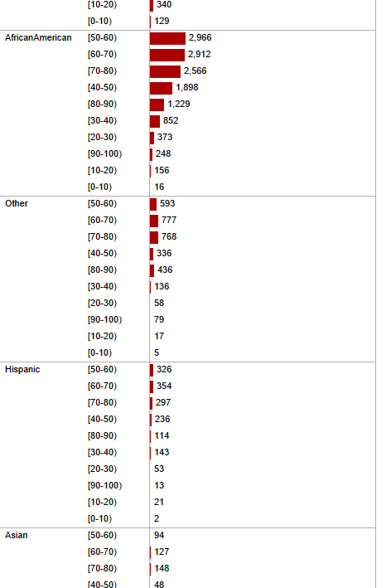
EFFECTS OF ETHNICITY REGARDING PRIMARY DIAGNOSIS AND DISCHARGE LOCATION
Utilizing These 3 Graphs I wanted to display the amount of patients who suffer from certain illnesses relating to Diabetes and the effect their age had on where they would be discharged to.

Slide 18
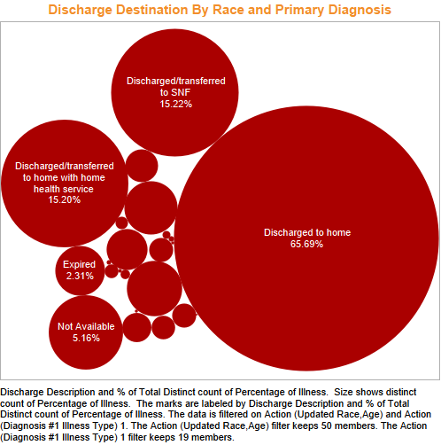
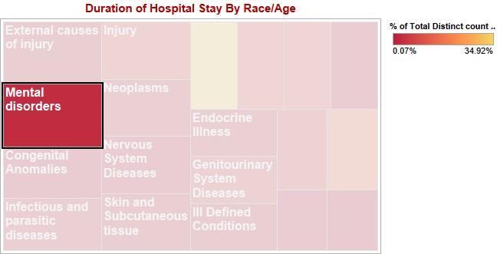
Discharge Percentage/ Initial Diagnosis

